Slide 1

FASTAI Live video logo obfuscation
Cat Tensors
Scott Zanevra, Isaac Powell, Deyan Zafirov (Deki), Naziah Siddique, Moji Ghadimi

Slide 2
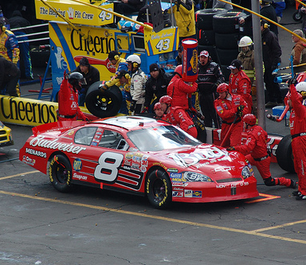
Project Objective & Problem Statement
Project aims to DETECT and OBFUSCATE a brand logo from clothing in a live video feed
Many movies, TV shows, music videos, and other visual media tend to blur out or remove logos of certain companies
This is widely known as product displacement
For example: Dale Earnhardt Jr’s #8 Chevrolet Monte Carlo was used in the animated film Cars with the beer advertising removed
Keep in mind: when a product or service of a brand is included in video media, this is a form of advertising
Producers would expect payment from the brand for this advertising
But if the brand refuses, then the producers can blur or remove the logo of the brand

Slide 3
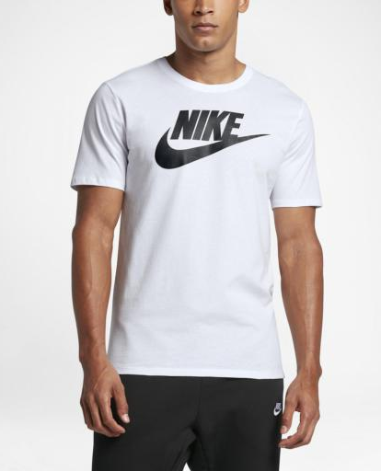
General Idea
The idea is to:
Detect a logo on items of clothing
Determine whether a person is wearing the clothing
If they are, then the logo is blurred
If the logo is not on a person, then it won’t be blurred
Apply this idea to a live video (webcam) stream
Our brand logo of choice is the Nike ‘swoosh’ logo
It is ubiquitous enough that it is easily recognisable and was easier to find a dataset compared to other logos (for example: AWS)

Slide 4
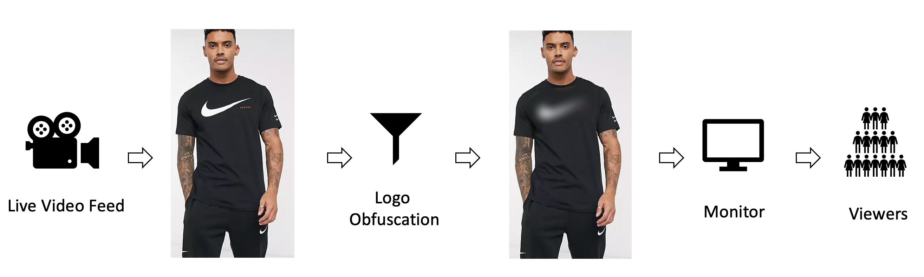
Workflow Approach
The basic idea is:
Train an object detection model to recognise the Nike logo
Detect the logo and obfuscate it
Train another object detection model to recognise people
Then do two inferences for a given image
Combine the models, and train a single model that can detect two labels
Detect people wearing the logo and obfuscate it
Apply this all to live video; someone wearing a Nike shirt will have the logo blurred

Slide 5
Our Process
Extrapolating from the previous slide, our process on getting from training a model, to detect the Nike logo, to blurring it via a live video stream, took the following form:
Firstly, used the Bing search API to download the Nike logo on jumpers, shoes, t-shirts and any other clothing
Annotated the Nike ‘swoosh’, Nike word, and people, using the open source LabelImg tool (https://pypi.org/project/labelImg/)
Investigate various Object Detection Framework’s to find the best one
Selected the IceVision framework (https://github.com/airctic/icevision)
Selected the COCO image dataset (https://github.com/cocodataset/cocoapi)
Had to limit this to people only
We then trained a model on the annotated image set, then validated on static images
Calculated the percentage overlap between the Nike logo and the human
Putting a bounding box around the human and the logo allowed us to blur the logo, where the overlap was true
The webcam client was implemented to detect humans and the Nike ‘swoosh’ logo on them
To detect humans (or objects) we trained multiple object-detection models using different model architecture: (1) RetinaNet, (2) EfficientDet, and (3) YOLOv5 (Ultralytics)
From these 3 we could adjust certain parameters (such as the learning rate or number of epochs) to determine which performed the best
Ultimately, we found that Model 1 and Model 3 were giving us better results, so refined these two, eventually sticking with Model 3 as our better model

Slide 6
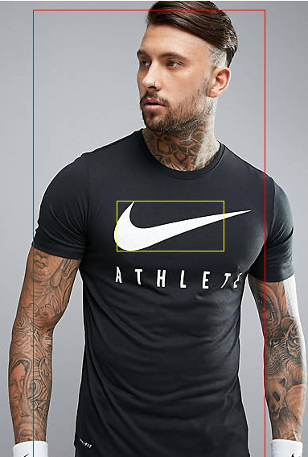
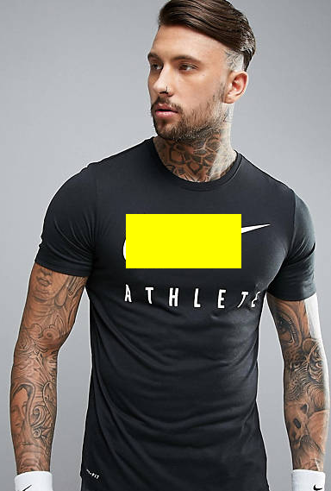
Configuring the training and validation datasets
Training with static images meant that we had to create bounding boxes to identify the person and the Nike logo
Initially, we placed a yellow box over the Nike logo once it was detected by the model
To get to this point, we applied augmentation and transformations to the training datasets

Slide 7
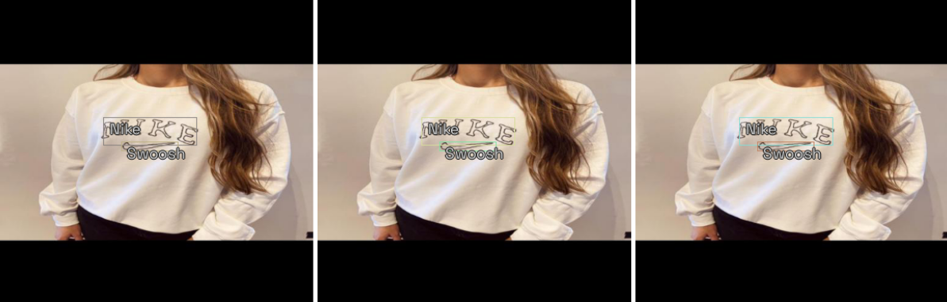
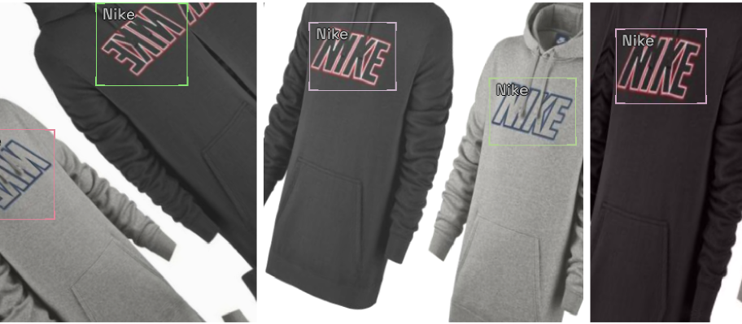
Dataset augmentation and transformations
Data augmentations are essential for our training and getting good results
IceVision comes with the Albumentations library for defining and executing transformations
Albumentation’s default aug_tfms randomly applies these transformations, such as rotation, cropping, horizontal flips, etc.

Slide 8
Training the Model
To train the models and test them, the notebooks train.ipynb and infer.ipynb (in “src/train/”) are used
The training method achieved a COCO metric of 0.70 for model 3 (yolo5) and 0.42 for model 1 (Retinanet)
This training method was a 3 step process:
Step 0: Training the head with weight decay of 0.2 (to prevent overfitting)
Step 1: Training the whole model with weight decay of 0.2 (to prevent overfitting)
Step 2: Training the whole model without weight decay

Slide 9
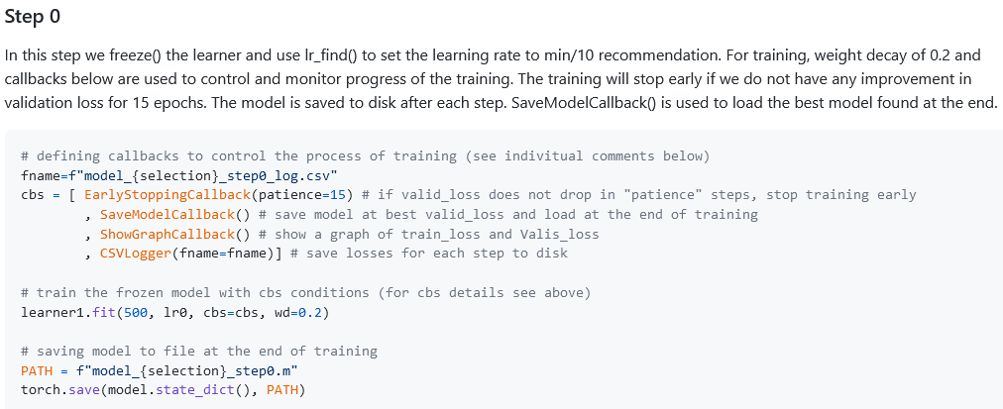
Step 0

Slide 10
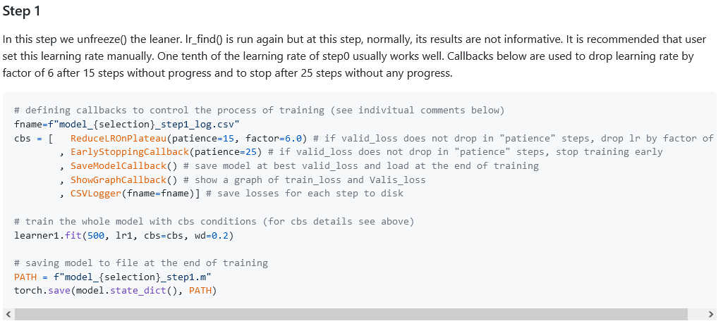
Step 1

Slide 11
Step 2
Here we remove the weight decay
It’s recommended that the user set the learning rate manually to the largest possible value (that won’t deteriorate the validation loss of the previous step)
The same Callbacks are used as Step 1, to drop the learning rate by a factor of 6, after 15 epochs without progress, and to stop after 25 epochs without progress
Implementing these 3 steps improved Model 3 (YOLOv5) more so over Model 1 (Retinanet), however we will still compare the two models

Slide 12
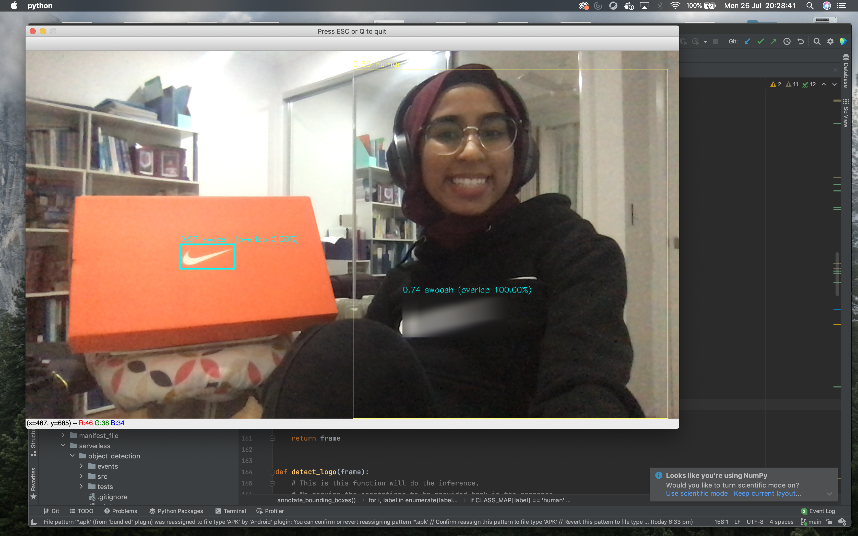
Model 1 examples
Model 1 accurately detected the Nike swoosh logo on Naziah’s jumper, then blurring it, whilst also detecting it on the orange box, but not blurring it

Slide 13
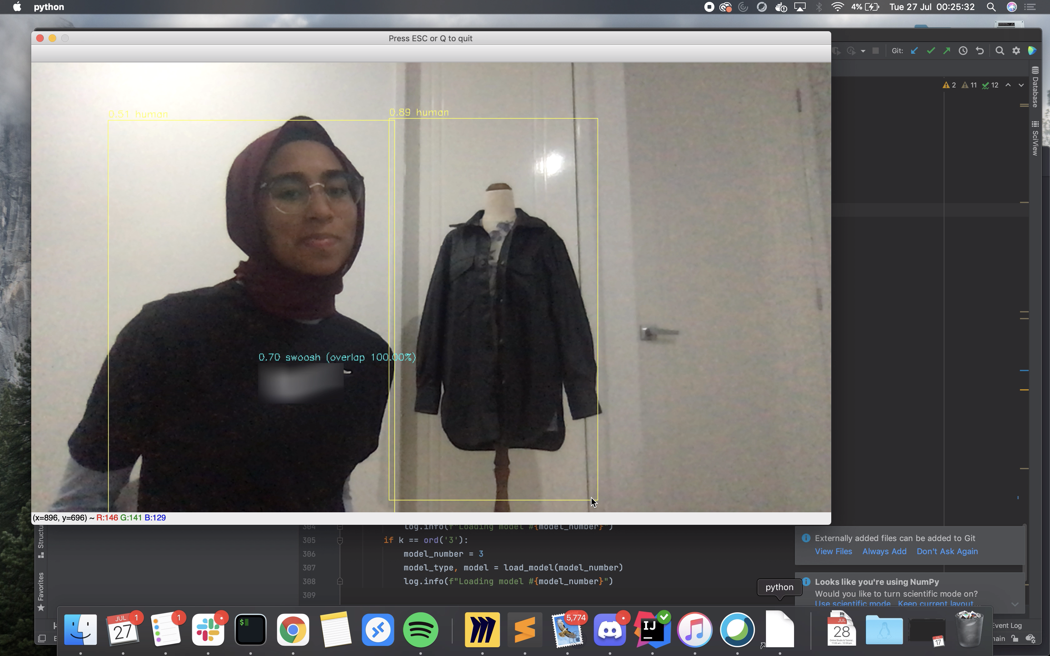
Examples continued
Although using Model 1 was not entirely accurate in detecting only humans, it still provides a good proof of concept (here it ascribes a higher value to the mannequin)

Slide 14
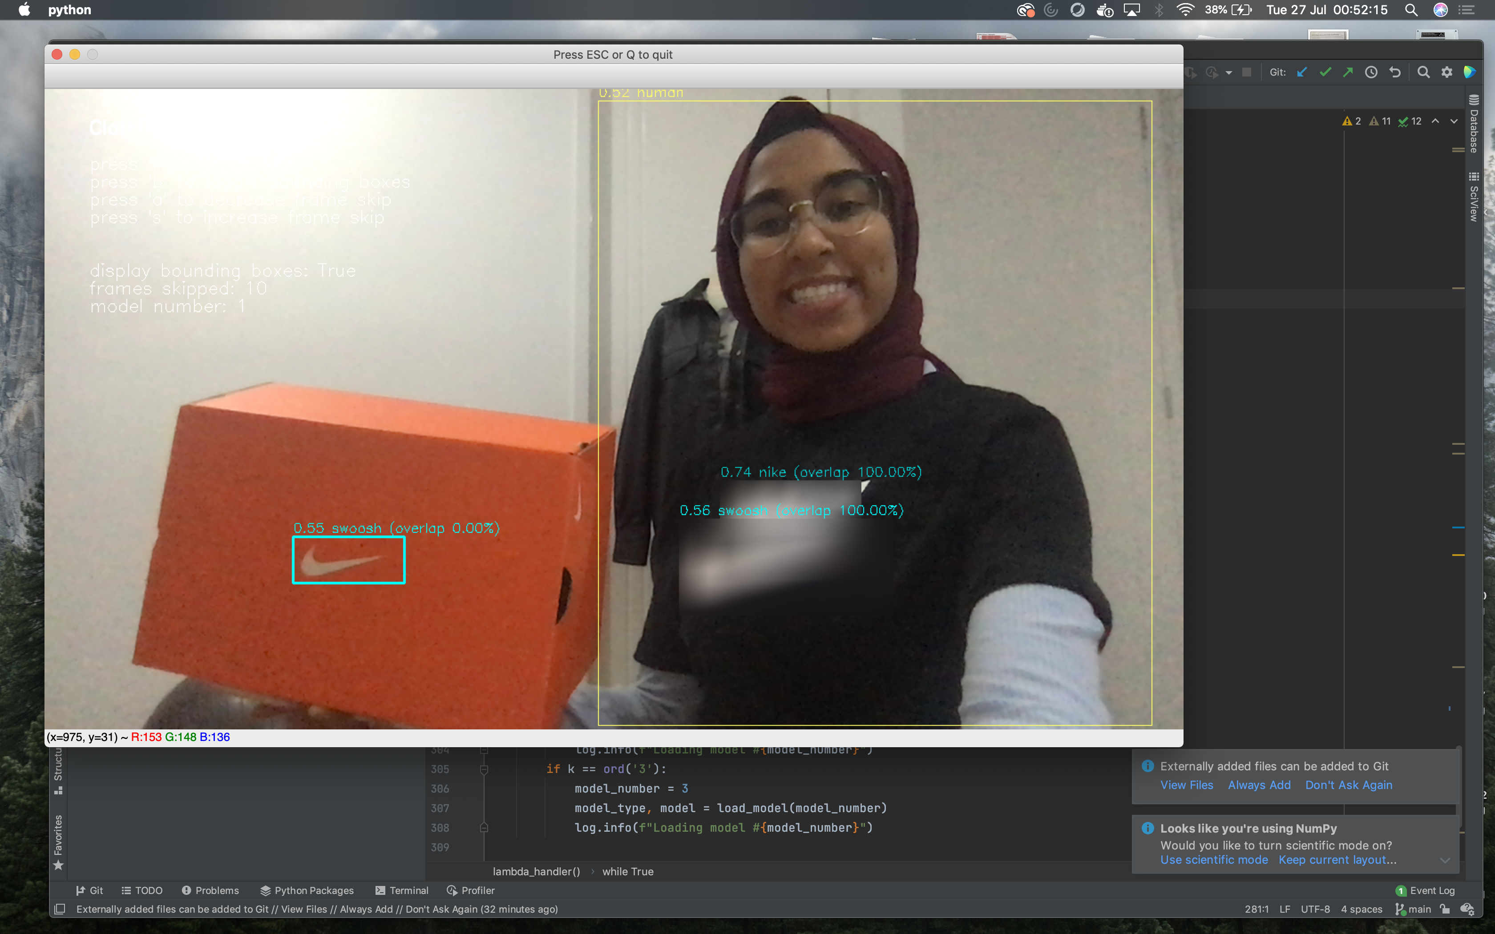
Examples continued
In this example, using Model 1, our model is able to detect the Nike text and ‘swoosh’ logo. Again, the orange box is still unblurred

Slide 15
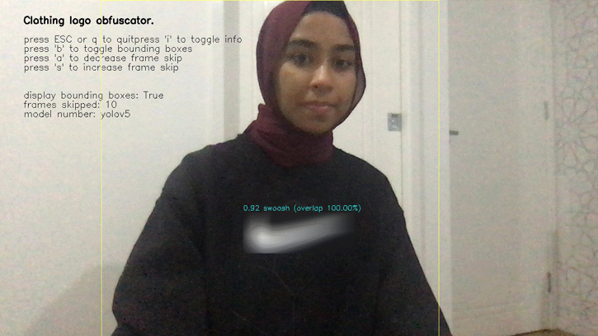
Model 3 examples

Slide 16
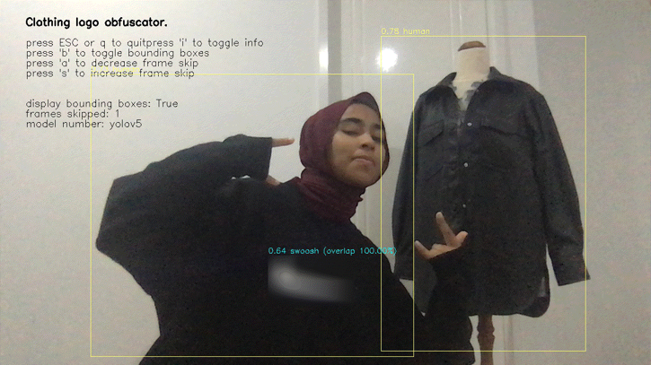
Examples continued

Slide 17
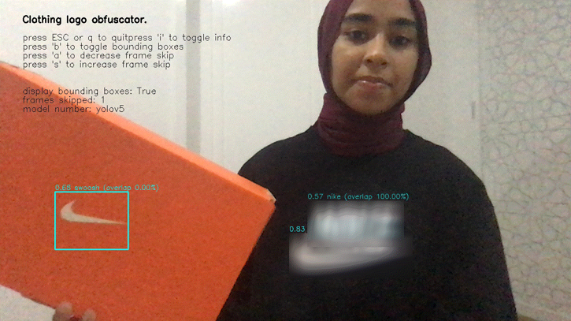
Examples continued

Slide 18
Limitations and other thoughts
A possible limitation to the data was noted in this example. The model ascribes a higher value to the mannequin in a jacket (thinking it’s a person). This could indicate bias in the data because Naziah wears a headscarf, whilst the dataset doesn’t account for that.

Slide 19
Limitations and other thoughts
Older dataset had people in positions where they weren’t facing the camera
New dataset, we labelled the people wearing Nike branded clothing; lead to improved accuracy
Github repo: https://github.com/scottzanevra/fastai-live-video-logo-obfuscation
Either open the zipped file in our submission, or go through the Github link
Make sure to read the README.md file first

